Slide 1

Development of
a standard phantom
for CEST MRI
Alexander M. Quach,^{1,2} Emily A. Thompson,^{1,2} Erin P. Snoddy,^{1,2} Tianzhe Li,^{1,2} Jingfei Ma,³ Mark D. Pagel^{1,2,3}
Department of Cancer Systems Imaging, MD Anderson Cancer Center, Houston, TX, USA
University of Texas Health Sciences Center, Houston, TX, USA
Department of Imaging Physics, MD Anderson Cancer Center, Houston, TX, USA

Slide 2

References
Yao J, Wang C, Raymond C, Bergstrom B, Chen X, Das K, Kim ZS, Le AN, Lim MW, Pham JAN, Prusan JD, Rao SS, Nathanson DA, Ellingson BM. A physical phantom for amine chemical exchange saturation transfer (CEST) MRI. MAGMA 2021;34:569-580. DOI: 10.1007/s10334-020-00902-z
Delli Castelli D, Terreno E, Aime S. Yb(III)-HPDO3A: a dual pH- andtemperature responsive CEST agent. Angew Chem Int Ed Engl 2011;50:1798–1800. DOI: 10.1002/ange.201007105
Aime S, Calabi L, Biondi L, De Miranda M, Ghelli S, Paleari L, Rebaudengo C, Terreno E. Iopamidol: exploring the potential use of a well-established X-ray contrast agent for MRI. Magn Reson Med 2005; 53: 830–834. DOI: 10.1002/mrm.20441
Liang Y, Bar-Shir A, Song X, Gilad A, Walczak P, Bulte JWM. Label-free imaging of gelatin-containing hydrogel scaffolds. J Biomaterials 2014;42:144-150. DOI: 10.1016/j.biomaterials.2014.11.050
McMahon M, Gilad A, Zhou J, Sun PZ, Bulte J, van Zijl PC. Quantifying exchange rates in chemical exchange saturation transfer agents using the saturation time and saturation power dependencies of the magnetization transfer effect on the magnetic resonance imaging signal (QUEST and QUESP): pH calibration for poly-L-lysine and a starburst dendrimer. Magn Reson Med 2006;55:836 – 847. DOI: 10.1002/mrm.20818
Haris M, Nanga RPR, Singh A, Cai K, Kogan F, Hariharan H, Reddy R. Exchange rates of creatine kinase metabolites: Feasibility of imaging creatine by chemical exchange saturation transfer MRI. NMR Biomed 2012;25:1305-1309. DOI: 10.1002/nbm.2792. DOI: 10.1002/nbm.2792
van Zijl PC, Jones CK, Ren J, Malloy CR, Sherry AD. MRI detection of glycogen in vivo by using chemical exchange saturation transfer imaging (glycoCEST). Proc Natl Acad Sci USA 2007;104:4359–4364. DOI: 10.1073/pnas.0700281104.
Chan KW, McMahon MT, Kato Y, Liu G, Bulte JW, Bhujwalla ZM, Artemov D, van Zijl PC (2012) Natural D-glucose as a biodegradable MRI contrast agent for detecting cancer. Magn Reson Med 2012;68:1764–1773.
Wermster FC, Maus B, Portner HO, Dreher W, Bock C. CO₂ induced pHi changes in the brain of polar fish: A TauCEST application. NMR Biomed 201831:e3955. DOI:10.1002/nbm.3955
Lee JS, Xia D, Jerschow A, Regatte R. In vitro study of endogenous agents at 3T and 7T. Contrast Media Molec Imaing 2016;11:4-14. DOI: 10.1002/cmmi.1652.
Keenan KE, Stupic KF, Russek SE, Mirowski E. MRI-visible liquid crystal thermometer. Magn Reson Med 2020;84:1552-1563. DOI: 10.1002/mrm.28224.
Keenan KE, Wilmes LJ, Aliu SO, Newitt DC, Jones EF, Boss MA, Stupic KF, Russek SE, Hylton NM. Design of a breast phantom for quantitative MRI. JMRI 2016;44:610-619. DOI: 10.1002/jmri.25214

Slide 3
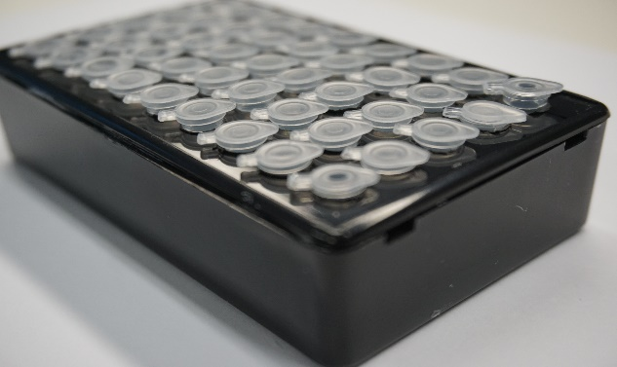
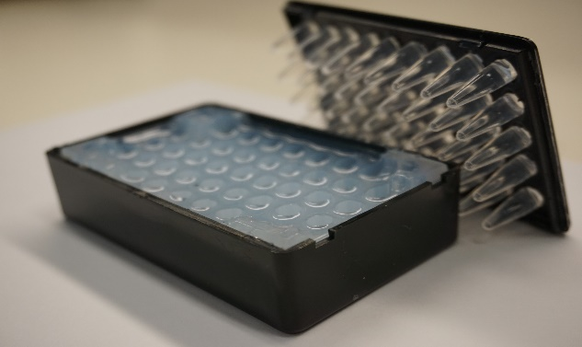

Phantom for a small animal MRI scanner
B₁
B₀
140
1
120
B₁ (%)
B₁ (%)
box phantom for 72 mm volume coil
Plastic electrical box
holes drilled into the top
30 “PCR” eppendorf tubes in homogenous coil volume
200 μL volume
Filled with 2% wt/vol agar
Heat for 15-20 sec in microwave, stir, repeat 4-6 times until dissolved.
Pour into box to fill to top of box
Insert empty tubes into box & agar to form holes
Wait 4 hours in 4°C refrigerator, 18-24 hours at r.t.
Remove tubes, replace with sample tubes.
100
0
80
60
-1
Phantom for 35 mm volume coil
PCR Eppendorf tube in 50 mL conical tube
1-2 PCR tubes
200 μL volume
Filled with water or agar

Slide 4
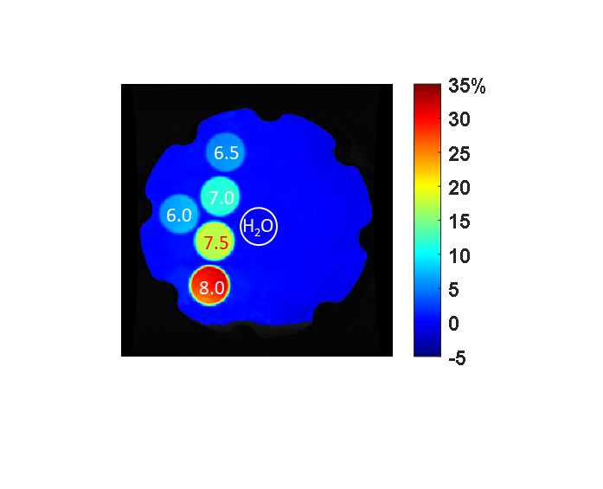
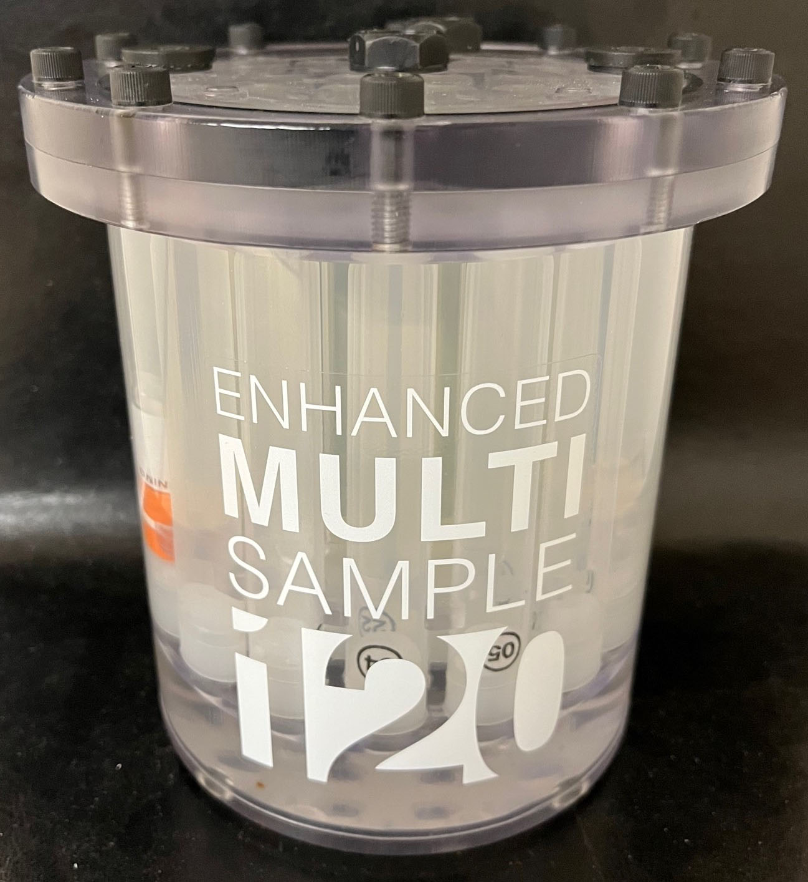
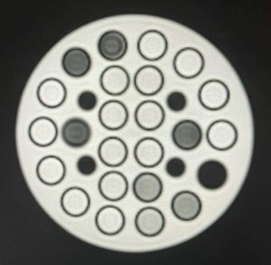
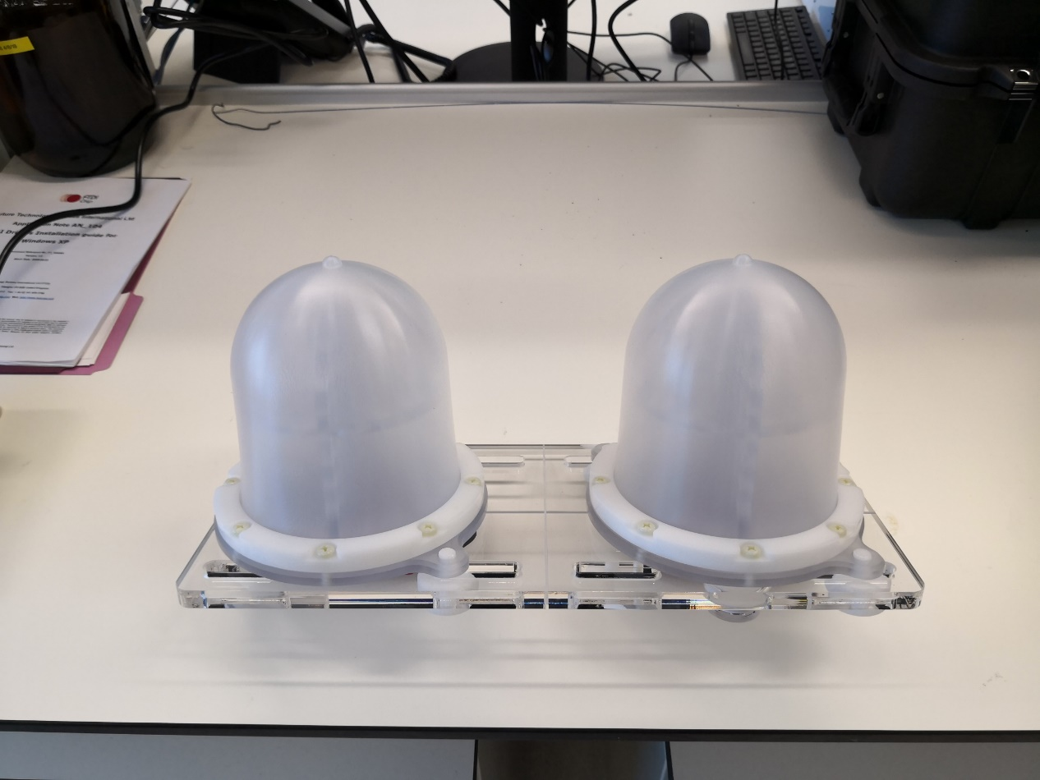
Phantoms for a clinical MRI scanner
% CEST
-10%
+10%
% CEST
Cylindrical phantom
Gold Standard Phantoms
16 cm diameter
16.5 cm height
24 containers, 30 mL volume
One tier
Spherical phantom
CaliberMRI, Inc.
18 cm diameter
13 containers, 30 mL volume
100 containers, 4 mL volume
One tier
Cylindrical phantom
Ellingson Group, UCLA
16.5 cm diameter
16.5 cm height
18 containers, 30 mL volume
two tiers
Yao, et al., MAGMA, 2021
Breast phantom
CaliberMRI, Inc.
18 cm diameter
Four 15 mL tubes, twelve 5 mL tubes
One tier
Keenan, et al., JMRI, 2016

Slide 5
Phantom Materials for a clinical MRI scanner
Sample | Material | Source | Saturation Freq. (ppm) | Conc. (mM) | pH (number of values) | T1 time (sec) | Phantom
paraCEST agent | Yb-HPDO3A¹ | Cage Chemicals | 71, 99 | 10, 15, 20, 25, 50 | 6.0-7.5 (8) | 0.2, 0.5, 1.0, 2.25 | sphere
diaCEST agent | Iopamidol (Isovue™) | Bracco Diagnostics | 4.2, 5.6 | 10, 15, 20, 25, 50 | 6.0-7.5 (8) | 0.2, 0.5, 1.0, 2.25 | sphere
gelatin | Verisol | Gelita | 3.5 | 7.5% wt/vol | 6.0-7.5 (5) | 0.2, 0.5, 1.0, 2.25 | sphere, cylinder
peptide | poly-l-lysine | Sigma Aldrich | 3.5 | 0.1% wt/vol | 6.0-7.5 (5) | 0.2, 0.5, 1.0, 2.25 | sphere
warm metabolite | creatine | Sigma Aldrich | 1.8 | 10, 15, 20, 25, 50 | 6.0-7.5 (5) | 0.2, 0.5, 1.0, 2.25 | sphere
glucose | glucose | Sigma Aldrich | 0.8 | 10, 15, 20, 25, 50 | 6.0-7.5 (5) | 0.2, 0.5, 1.0, 2.25 | sphere
cold metabolite | taurine | Sigma Aldrich | 2.8 | 10, 15, 20, 25, 50 | 6.0-7.5 (5) | 0.2, 0.5, 1.0, 2.25 | cylinder
1. HPDO3A: 10-(2-hydroxypropyl)-1,4,7,10-tetraazacyclododecane-1,4,7-triacetic acid

Slide 6
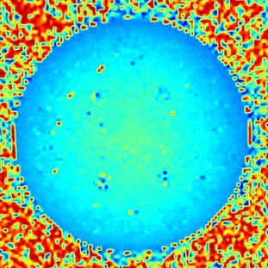
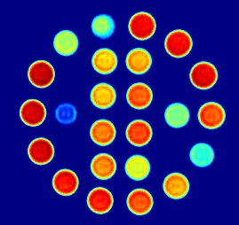
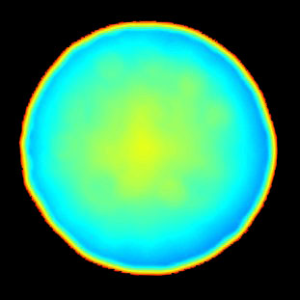
Cylinder Phantom from Gold Standard Phantoms
Gelatin: 7.5% wt/vol, pH 6.0-7.5, T₁ 0.4-2.25 sec
Taurine: 10-50 mM, pH 6.5-7.5, T₁ 0.4-2.25 Sec
2.25
B₁ homogeneity
2.00
15%
1.75
1.50
10%
T₁ relaxation time (sec)
1.25
5%
RF power
1.00
0%
0.75
-5%
0.50
-10%
0.25
-15%
B₀ homogeneity
0.8
1.0
0.7
0.6
0.5
0.5
T₂ relaxation time (sec)
0.4
Water MR frequency (ppm)
0.3
0
0.2
-0.5
0.1
0.0
-1.0

Slide 7
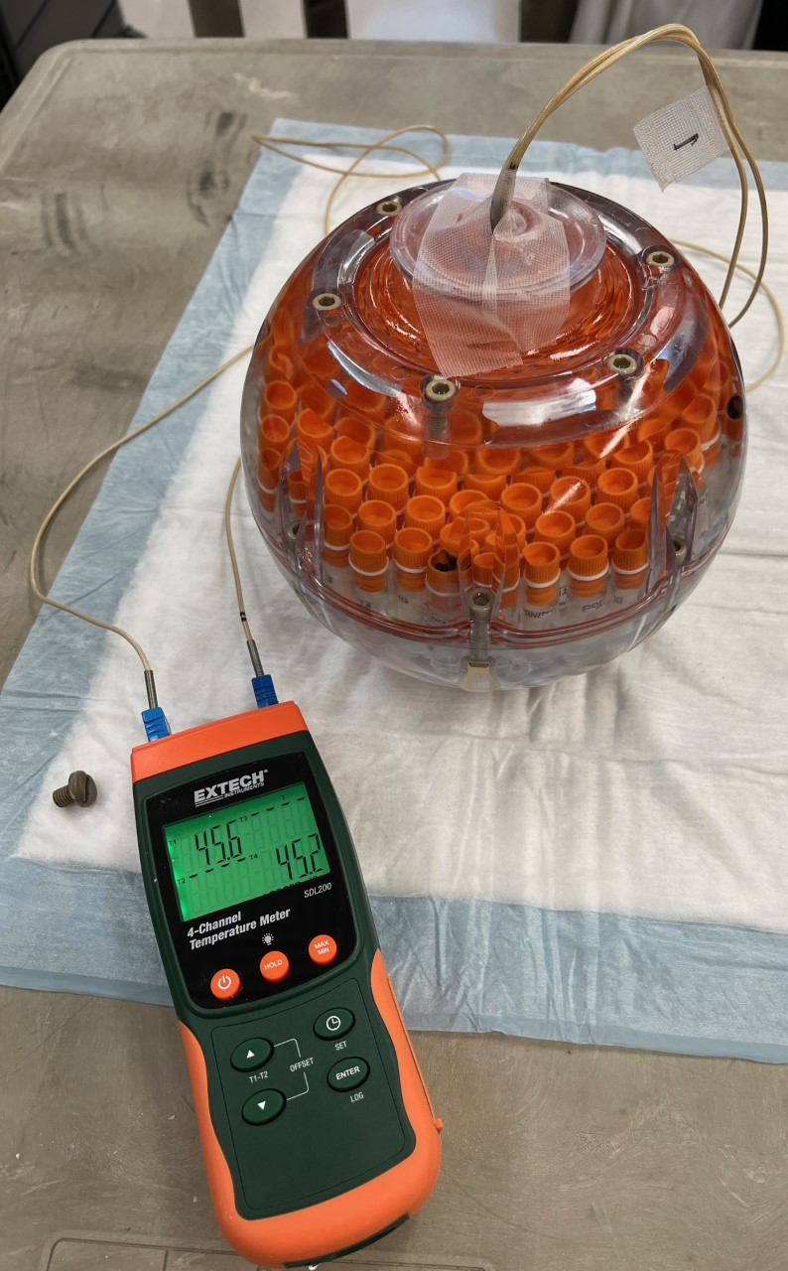
Temperature Stability for a Clinical MRI scanner
Keenan, et al., MRM, 2020
sphere phantom with 100% ethylene glycol
38.0
37.5
Temperature (°C)
37.0
36.5
36.0
PureTemp-37
PureTemp, LLC (Octochem, Inc.)
ethylene glycol:
An MRS thermometer
Future studies: 0°C with an ice-water slurry following the procedure for a diffusion-weighted MRI phantom

Slide 8
ACKNOWLEDGEMENTS
Collaborators
Priya Bhosale
Wui Chong
Chris Flask (CWRU)
Seth Gammon
Shreya Goel (Utah)
Jason Johnson
Jingfei Ma
Federica Pisaneschi
Gaiane Rauch
Sanhita Sinharay (IISC)
Elena Vinogradov (UTSW)
Small Animal Imaging Facility
Renee Chin
Jorge de la Cerda
Chetan Dhakan
Elijah Gonzalez
Grace Isakson
Tianzhe Li
Xiaofei Liang
Marty Pagel
Alex Quach
Caroline Robins
Bill Schuler
Ashley Shin
Erin Snoddy
Priya Trakru
Michelle Zalles
Funding
NIH/NCI R01 CA231513
NIH/NCI R01 CA269354
NIH/NCI R43 CA265603
NIH/NIBIB R21 EB028062
CPRIT RP190211
CPRIT RP220270

